Slide 1
/Day Care Project
Team Number : 1
Gokul Jayavel 002768982
Prem Kumar Raghava Manoharan 002726784
Janani Gopalakrishnan 002663579
Dhruv Parthasarathy 002919280
Varun Bharathi Jayakumar 002752810
Geetha Parthasarathy 002653850
Abhishek Krishna 002776672

Slide 2
/CONTRIBUTION
Sign-In and Sign-Up Page : Dhruv
Design Patterns and Immunization : Gokul
Student Registration and view update : Varun
Teacher Registration and Azure Database : Prem
Teacher view update and UI Design : Janani
UML Diagram Designing,Class view and update : Geetha
Email and Presentation : Abhishek

Slide 3
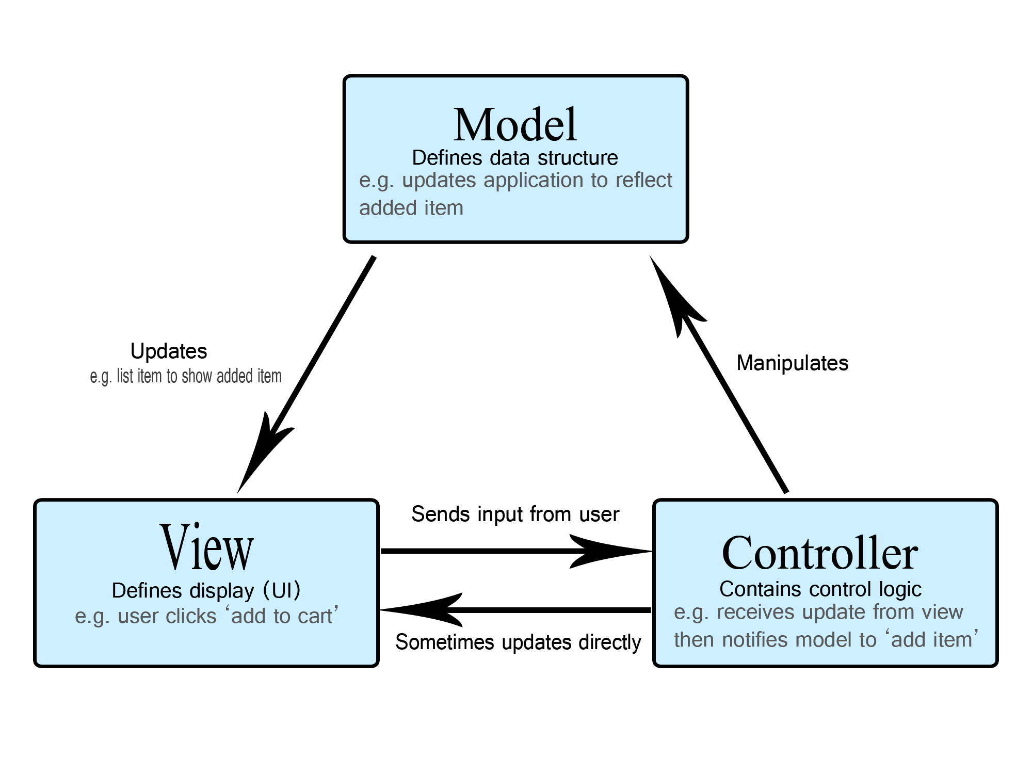


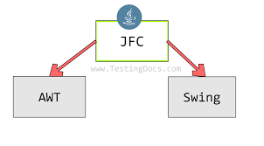
/Technologies Used
/The languages and frameworks used are
Java
Swing for GUI
MVC Architecture
Microsoft SQL (Azure cloud hosted)

Slide 4
/Features
Accessible Information panel for Day Care Manager
Easier to monitor the annual registration renewal for teachers and students.
Daycare manager can send reminder email to parents of the students whose immunization date is due within 15 days.
Easy to enroll students and teachers and capture the data
Simple record keeping for immunizations
Assign pupils to teachers in accordance with the laws of the state.
Group students and teachers into classrooms in accordance with the laws of the state.

Slide 5
/Object Oriented Design
Encapsulation
Abstraction
Inheritance
Polymorphism

Slide 6
/Design Patterns
Builder design Pattern
Eager singleton
Lazy singleton
Factory Design Pattern
Model View Control (MVC)

Slide 7
/MVC Design Pattern(Model-View-Controller)
Model
The Model component corresponds to all the data-related logic that the user works with.
View
The View component is used for all the UI logic of the application.
Controller
Controllers act as an interface between Model and View components to process all the business logic and incoming requests, manipulate data using the Model component and interact with the Views to render the final output

Slide 8
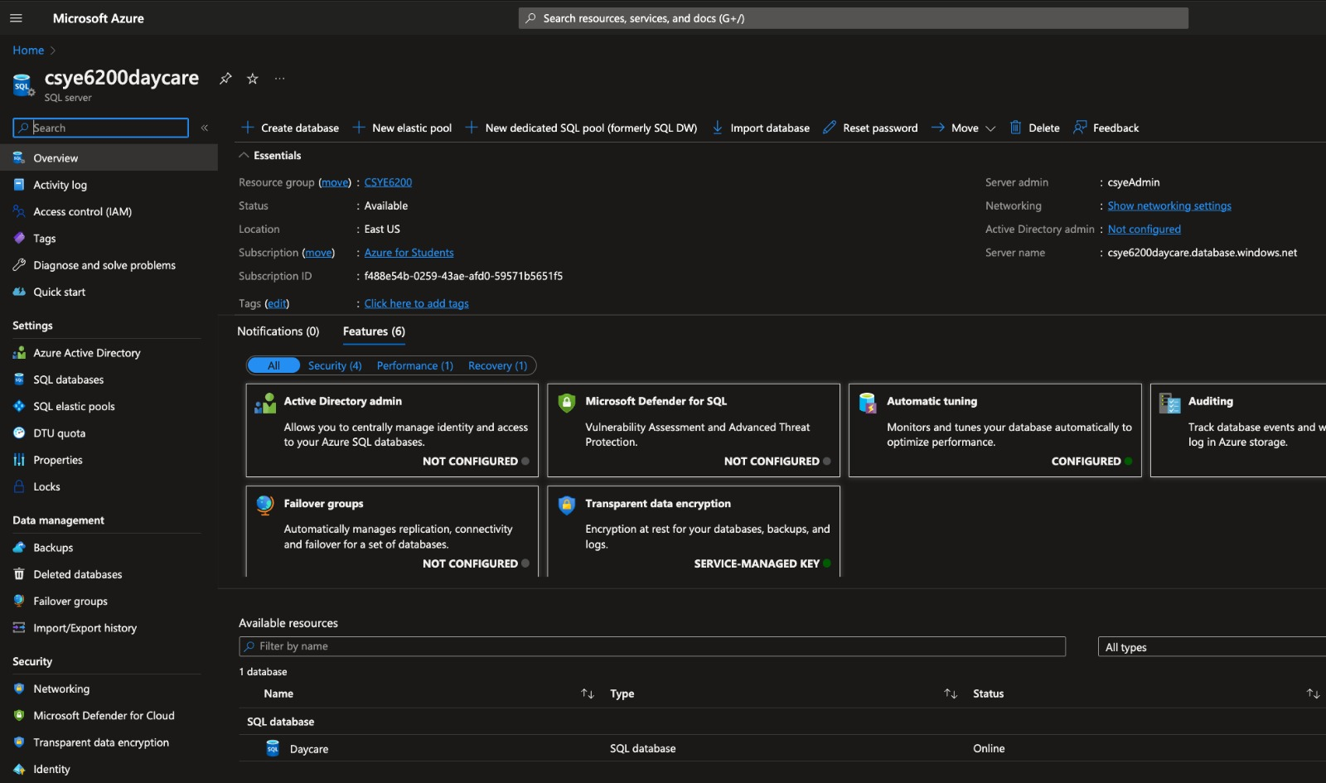
/Database

Slide 9
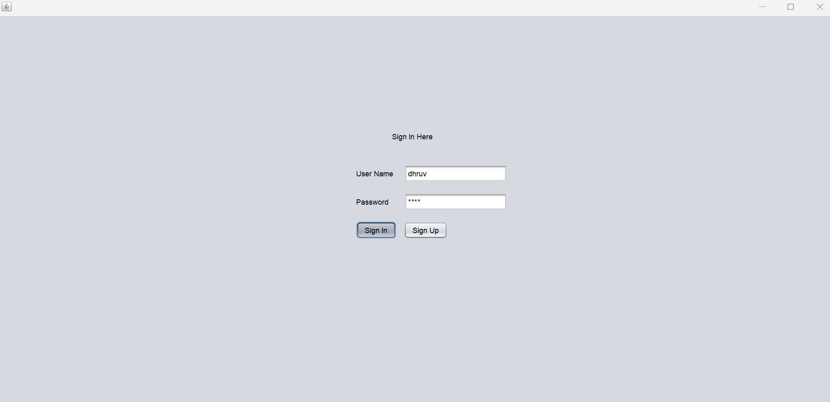
/Sign in Page
This is the Sign in page of the project

Slide 10
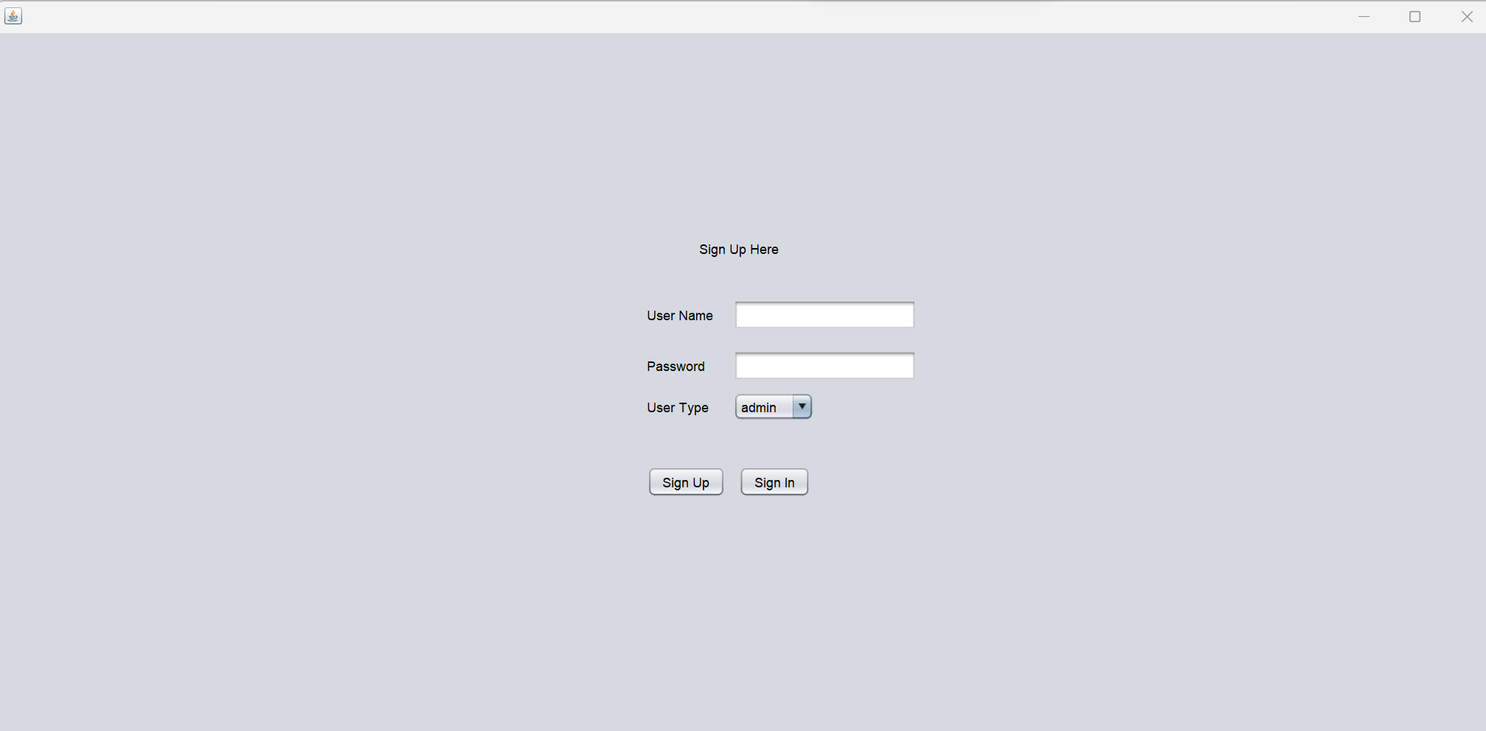
/Sign Up Page
This is the Sine up page of the project

Slide 11
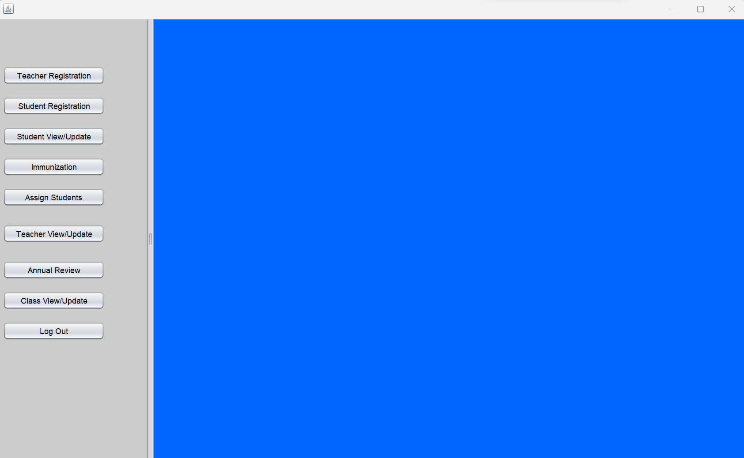
/Home Page
This is the Admin view for the Home page of the project

Slide 12
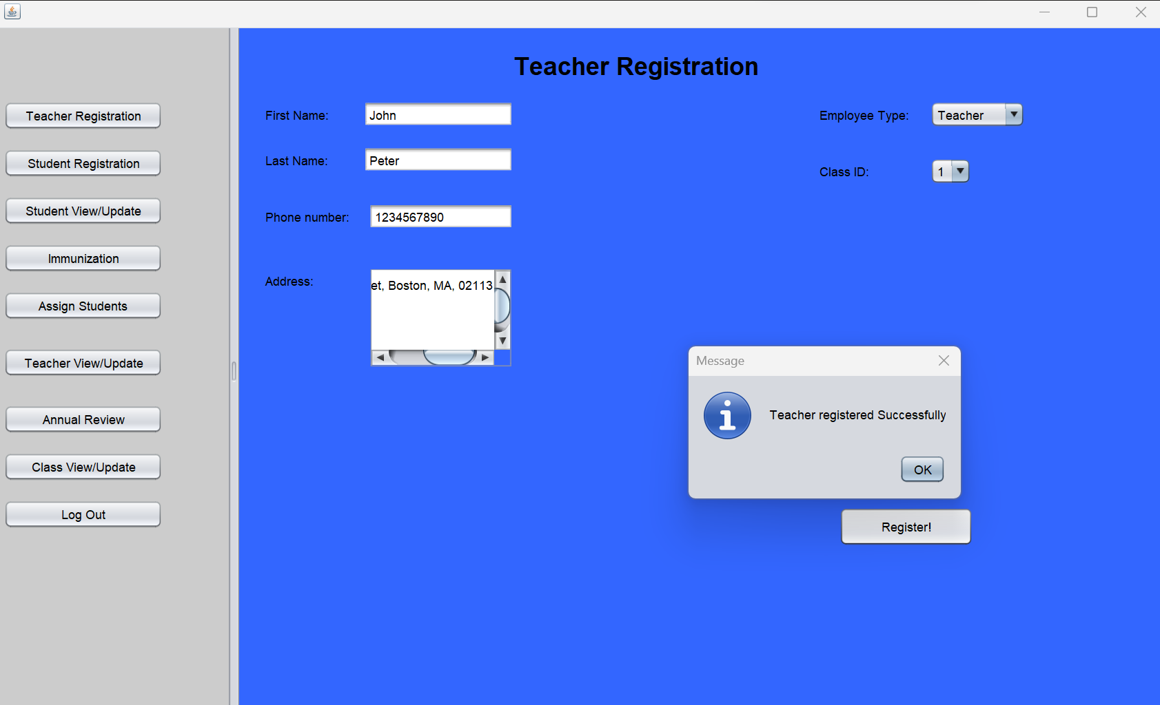
/Teacher Registration Page
This is the Admin view for the Teacher Registration Page of the project

Slide 13
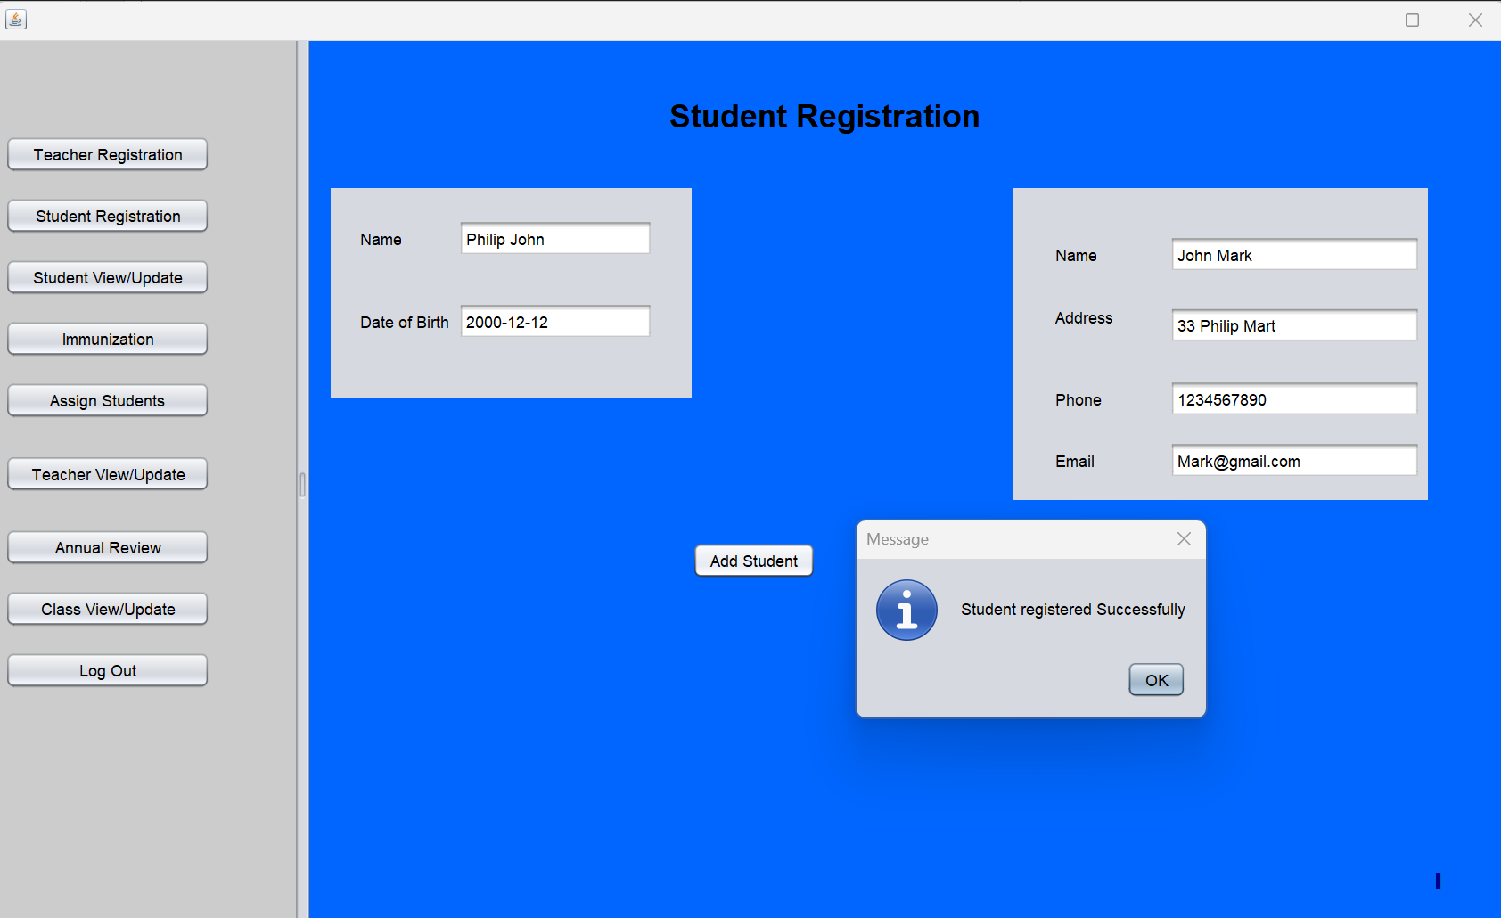
/Student Registration Page
This is the Admin view for the Student Registration Page of the project

Slide 14
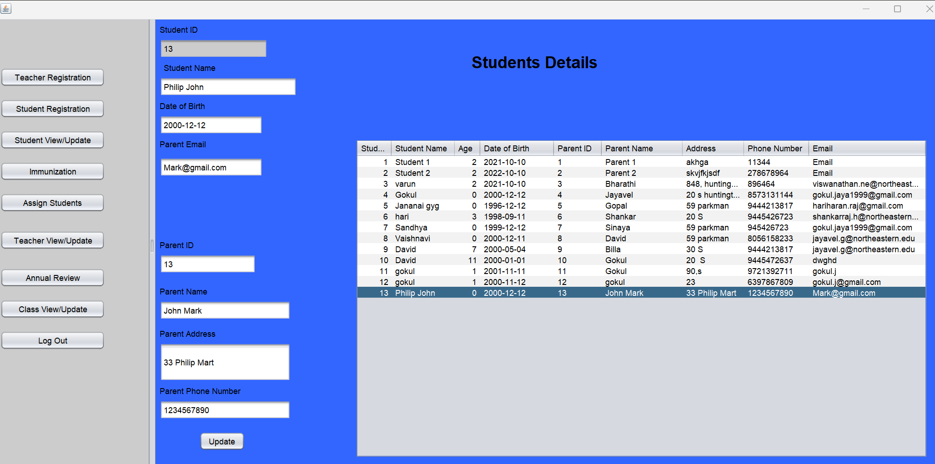
/Student Details Page
This is the Admin view for the Student Details Page of the project

Slide 15
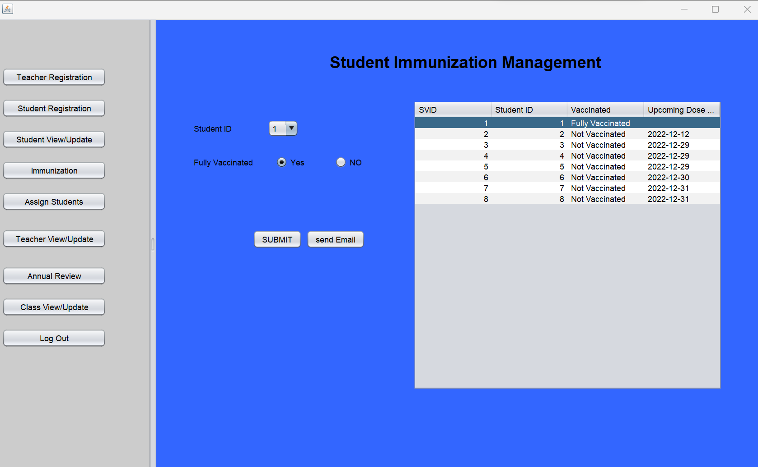
/Student Immunization Management Page
This is the Admin view for the Student Immunization Management Page of the project

Slide 16
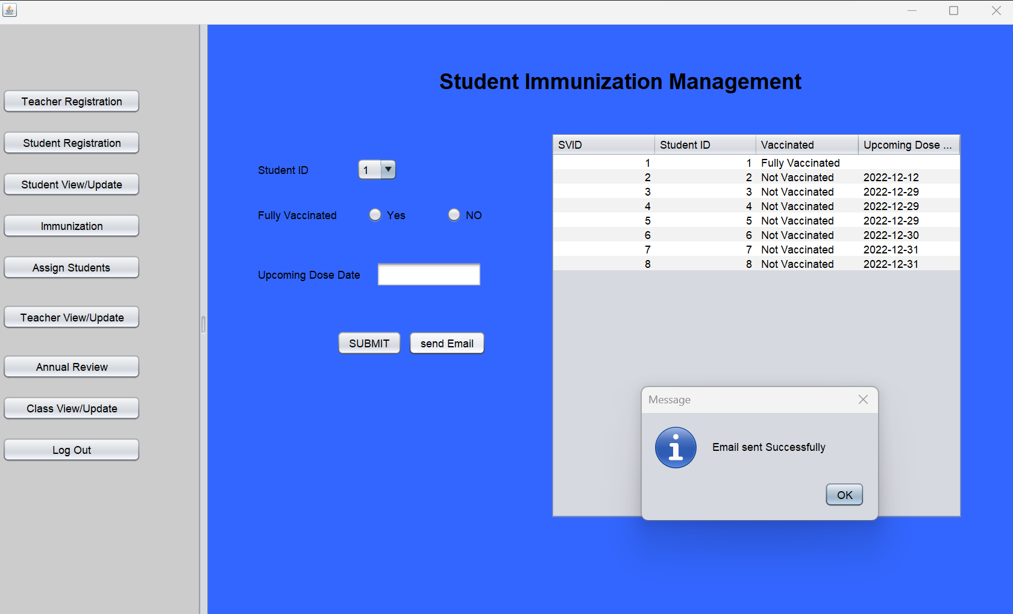
/Student Immunization Management Page
This is the Admin view for the Student Immunization Management Page of the project with email notification dialog box.

Slide 17
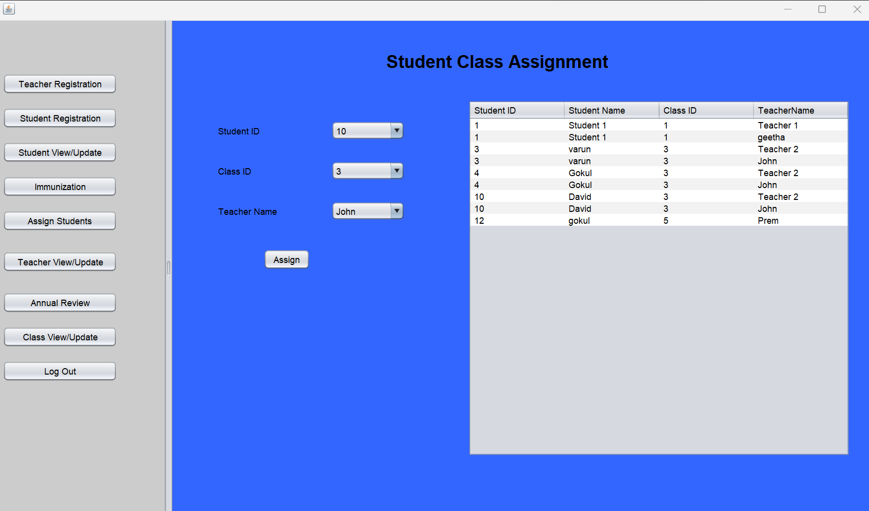
/Student Class Assignment Page
This is the Admin view for the Student Class Assignment Page of the project.

Slide 18
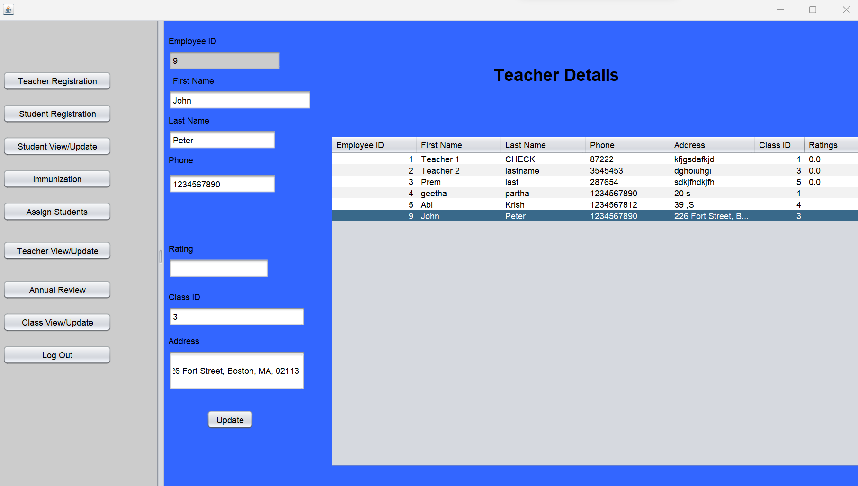
/Teachers Details Page
This is the Admin view for the Teachers Details Page of the project.

Slide 19
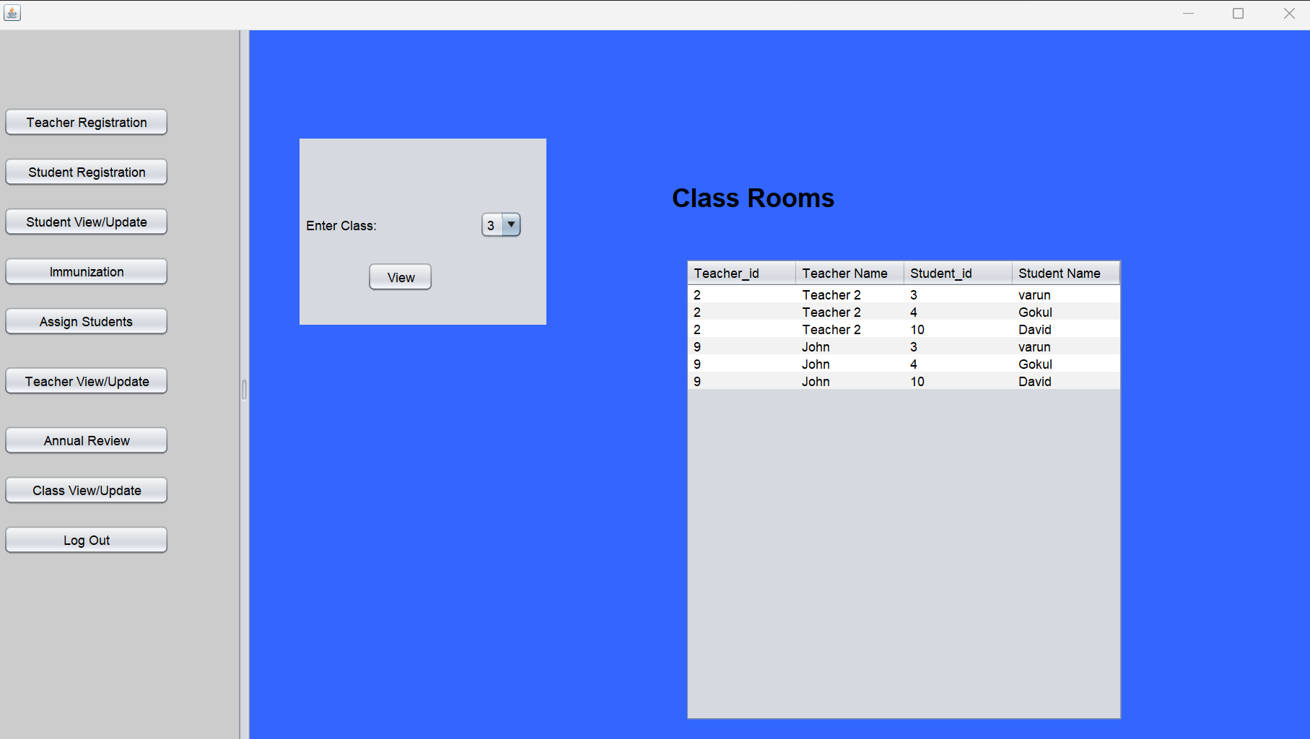
/Class Rooms Details Page
This is the Admin view for the Class Rooms Details Page of the project.

Slide 20
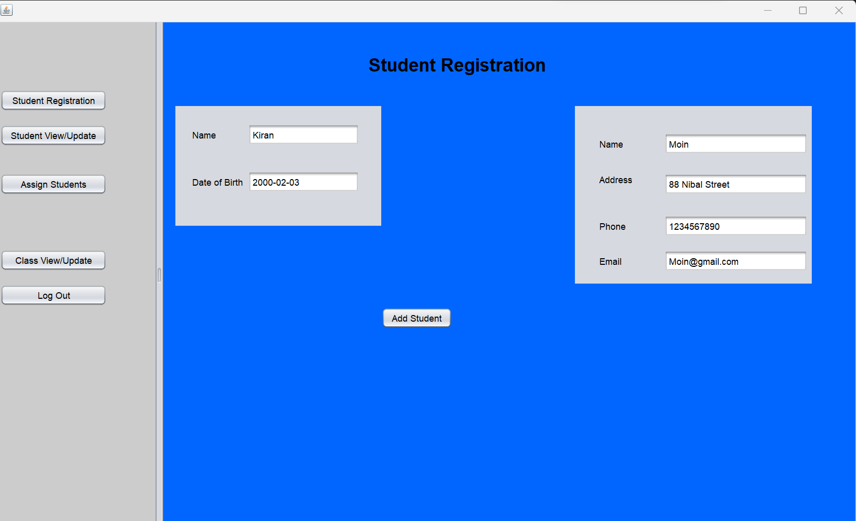
/Student Registration Page
This is the Teachers view for Student Registration Page of the project.

Slide 21
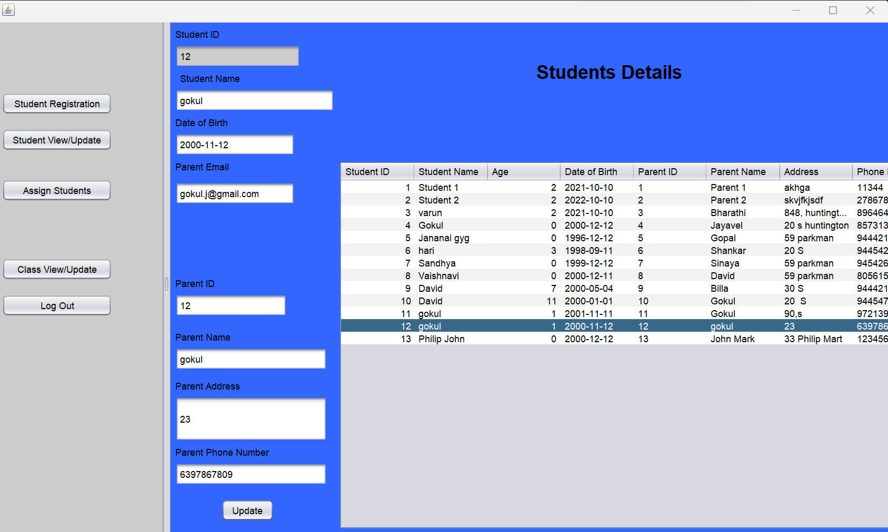
/Student Details Page
This is the Teachers view for Student Details Page of the project.

Slide 22
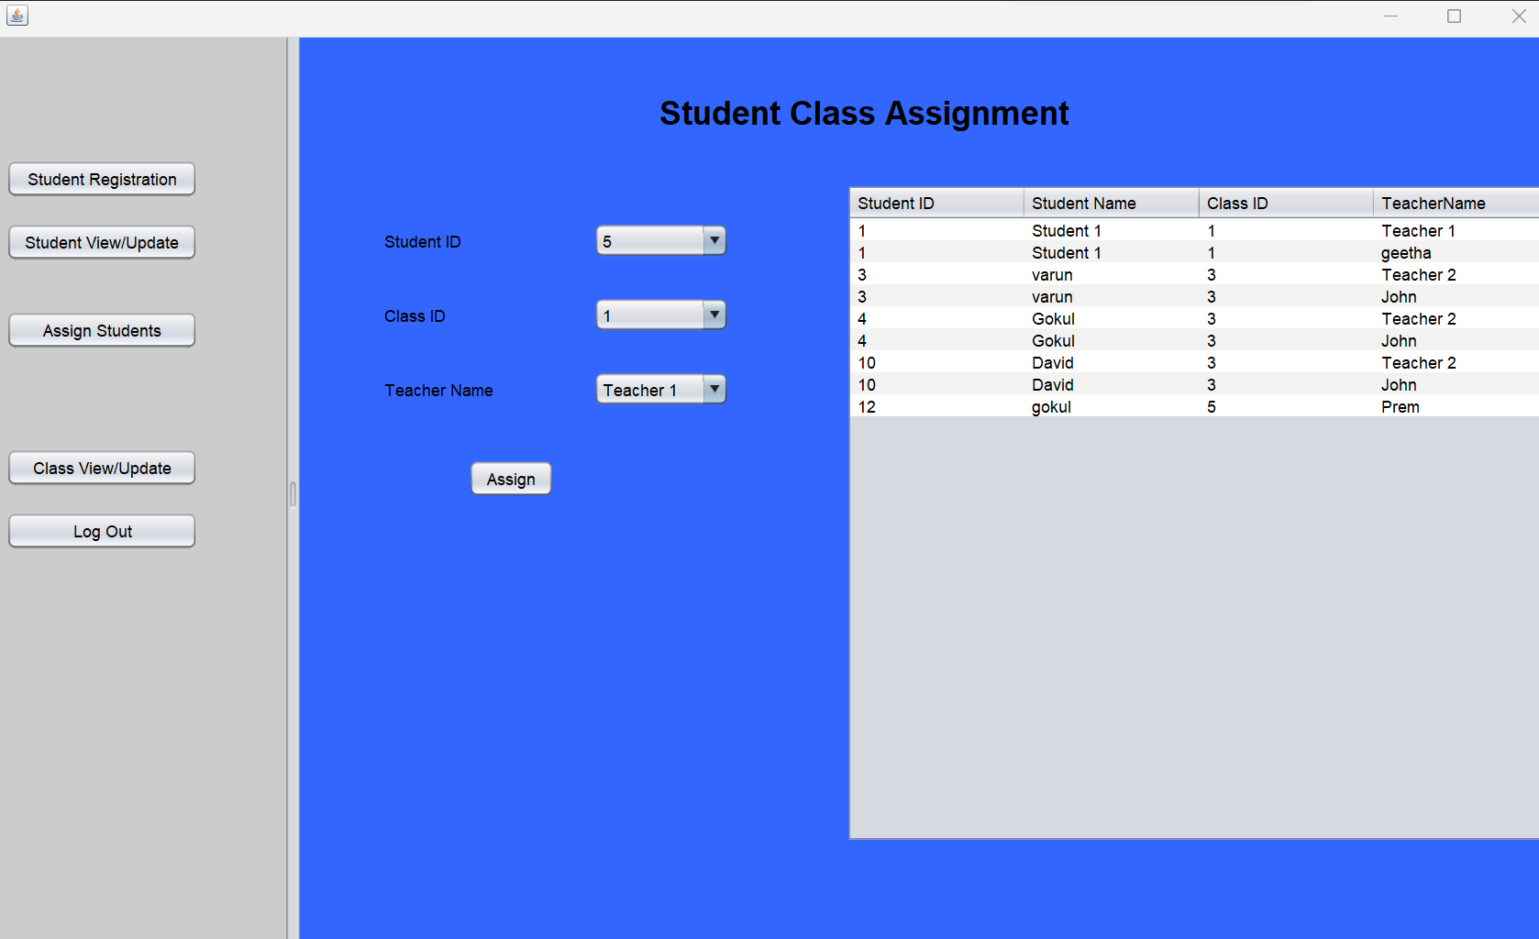
/Student Class Assignment Page
This is the Teachers view for Student Details Page of the project.

Slide 23
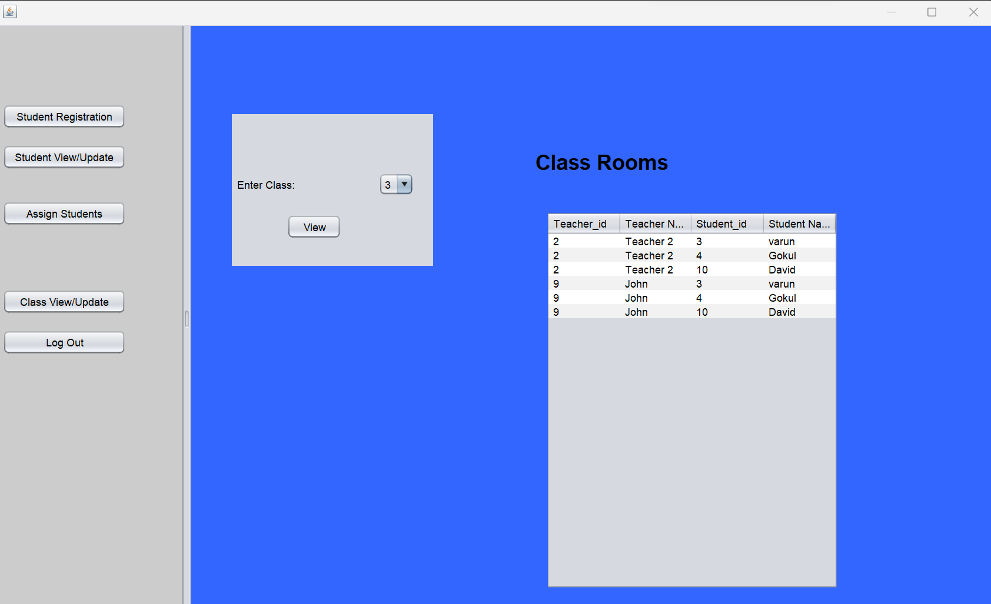
/Class Room Page
This is the Teachers view for Class Room Page of the project.

Slide 24
/Future enhancements
Using Angular as a frontend framework and spring boot as a backend java application, the UI portion can be made more interactive.
Hosting the application in the cloud with both frontend and backend as microservices.

Slide 25
<Thank You!>

